Slide 1







Presentation of Current and Forecasted Web Tools 2020/2021
Juan Manuel Floria
09/01/2021

Slide 2



OUTLINE
Executive Summary
Introduction
Methodology
Results
Visualization – Charts
Dashboard
Discussion
Findings & Implications
Conclusion
Appendix

Slide 3

EXECUTIVE SUMMARY
WebSystems Co. offers high-end bespoke shirts fitted with a proprietary Market Study.
Our stores are situated in some of the finest malls in the country, for every kind of neighborhoods. Our sales teams are well trained to make questions full of meaning from every sort of customers and make them feel confident about their accurate responses.
This report has been commissioned to describe the details of a proposed current and forecasted trends in the use of Web applications, as well as languages and platforms to be used within.
Drawing on figures from the past year, and applying predictive statistics techniques for 2021 year, the report shows that Microsoft Windows has become stagnant, while other OS are seeing record increases. After extensive research, the investigative department has determined that Java and C keep standing at the top of Languages used by programmers, while Django and Spring have reached the top positions quickly on the ranking of Web Frames all country around.
WebSystems Co. has determined that a increasing number of personal web pages, designed to give professional profiles without expensive investment, would create a substantial increase in using MySql and SQL Server as Databases. This report further details how the platforms would be used, the amount of hands-on research that has been done, and the projected results of adopting these technologies.

Slide 4

INTRODUCTION
This report is about the study market managed by our professionals with the ranking of programming languages, databases, webframes, and platforms as main topic. The study will not only convey the result of the current year, 2020, but also what is forecasted for the coming year 2021.
For reaching the user target demographic data has been used and the user target is 20 / 50 aged, medium incomes, city residents, degree studies, and self employed as professional dedication. Due to the fact pandemic has boosted working from home nowadays, as a goal for potential readers of this study can be cited the importance of choosing the best programming languages, as well as the database to be used, in the concrete platform for self-jobs and avoid wasting money in not used web tools and get a fine and suitable we resources wherefrom perform a good job results, not only fine done but also good transfer by the web.

Slide 5

METHODOLOGY
Primary Data Collection:
paper questionnaire or computer-assisted interviewing system. Case Studies, Checklists, Interviews, Observation sometimes, and Surveys or Questionnaires are all tools used to collect data.
Online Questionnaires, Focus Groups and Reporting.
Interviews.
Questionnaires
Reporting
Secondary Data Collection:
published books, journals and/or online portals. Forums and reputed Blogs which convey the trend of this Web development 20/21.
Existing Data.
This report has been commissioned to describe the details of a proposed current and forecasted trends in the use of Web applications, as well as languages and platforms to be used within.
Drawing on figures from the past year, and appliyind predictive statistics techniques for 2021 year, the report shows that Microsoft Windows has become stagnant, while other OS are seeing record increases. After extensive research, the investigative department has determined that Java and C keep standing at the top of Languages used by programmers, while Django and Spring have reached the top positions quickly on the ranking of Web Frames all country around.

Slide 6
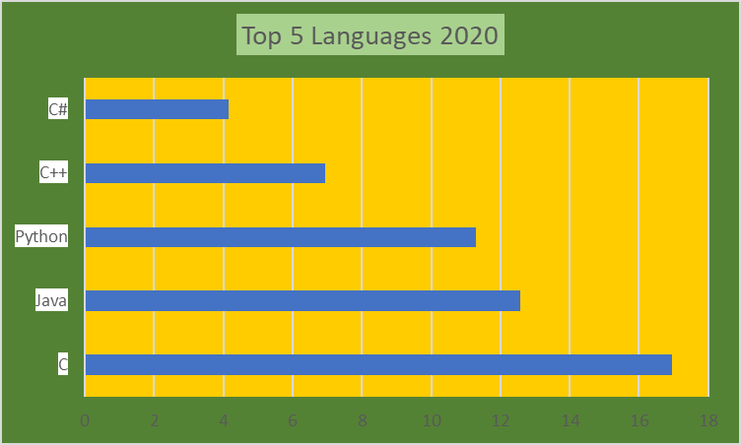
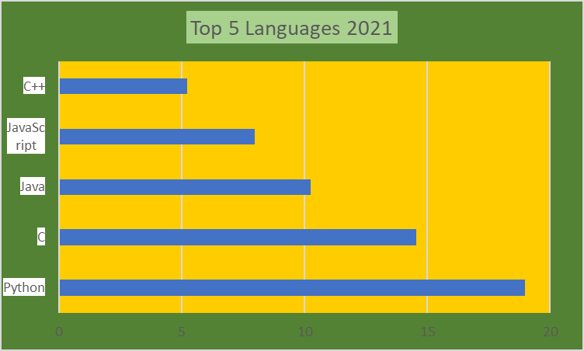
PROGRAMMING LANGUAGE TRENDS
Current Year 2020
Next Year 2021
<Bar chart of top 5 programming languages for the current year goes here.>
< Bar chart of top 5 programming languages for the next year goes here.>

Slide 7
PROGRAMMING LANGUAGE TRENDS - FINDINGS & IMPLICATIONS
Findings:
The top five most used languages has been the same for the last four years, with a participation of 52% in all the web market.
Java is the most used programs all over the web history and this year has been so.
Python is reaching its top position, 3rd this year, citing a clear rise since the last years.
Implications:
No need to change specialized programmer in a short or medium term, as the trend conveys so.
Java teaching and learning is a must, not only for companies but for professionals who want a job in TI.
Due to application on Machine Learning and AI. Python has been defined as a tool for new technologies in Deep Learning and Machine Learning

Slide 8
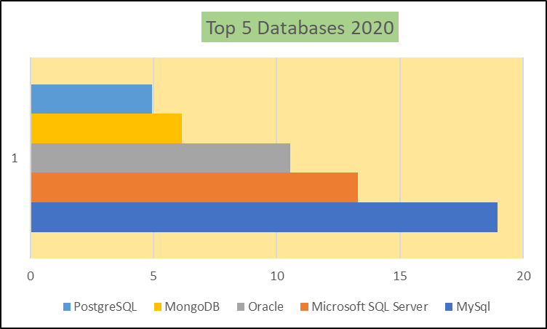
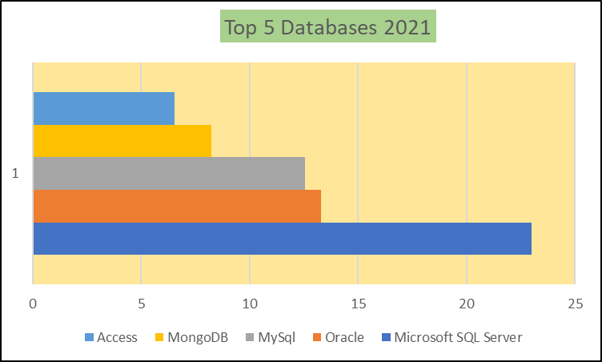
DATABASE TRENDS
Current Year 2020
Next Year 2021
< Bar chart of top 5 databases for the current year goes here >
< Bar chart of top 5 databases for the next year goes here.>

Slide 9
DATABASE TRENDS - FINDINGS & IMPLICATIONS
Findings:
Microsoft SQLServer is by difference the most used by programmers for the next year. It consolidates its position among the 15% preferred for the last 12 years.
Oracle has reached the third position in databases coming from down ones, it is about 13% part in this market.
Access shares a slight participation on the market, 6,52%, and Postgress (SQL) is not among the five tops now.
Implications:
Its BI components among the analytical processes make them the most appropriated for cutting edge TI.
Not only Microsoft will domain the databases on web, programmers are betting for most dynamics solutions nowadays.
Market goes to become more practical and easy-use by controlling Access once more. Postgress, with its down position, 7th, makes it clear that seems bit complicated to home run because of is installation procedures.

Slide 10
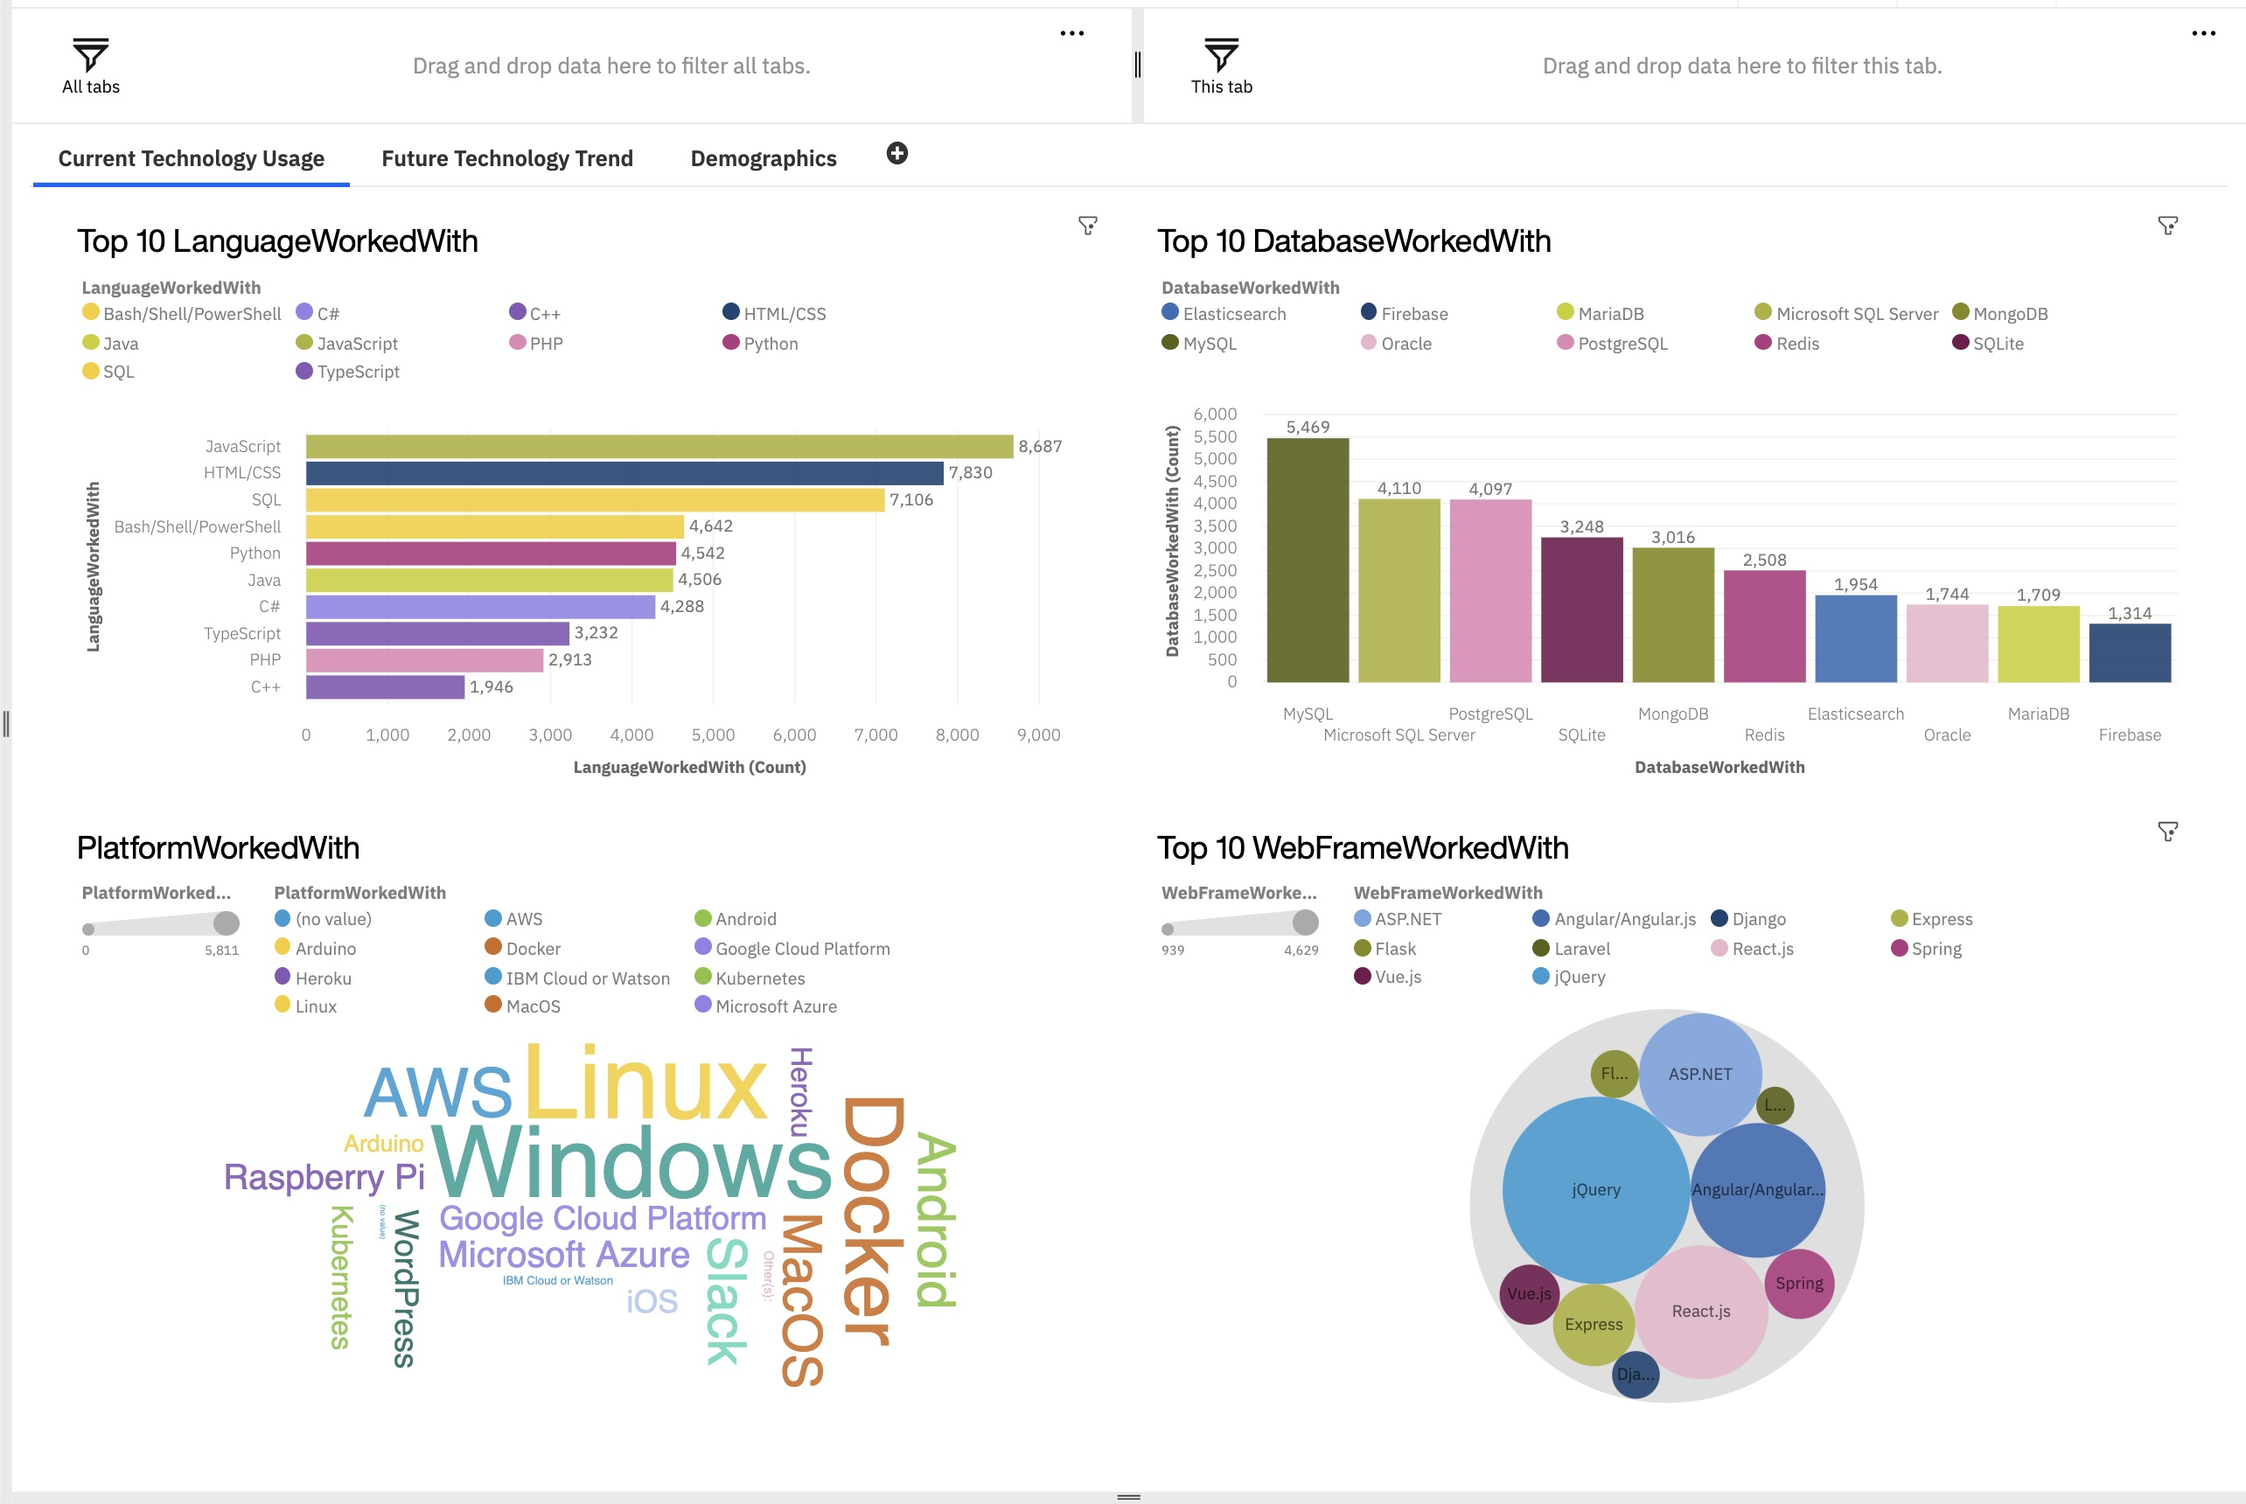

DASHBOARD
<The permanent link of the read-only view of the Cognos dashboard goes here.>

Slide 11
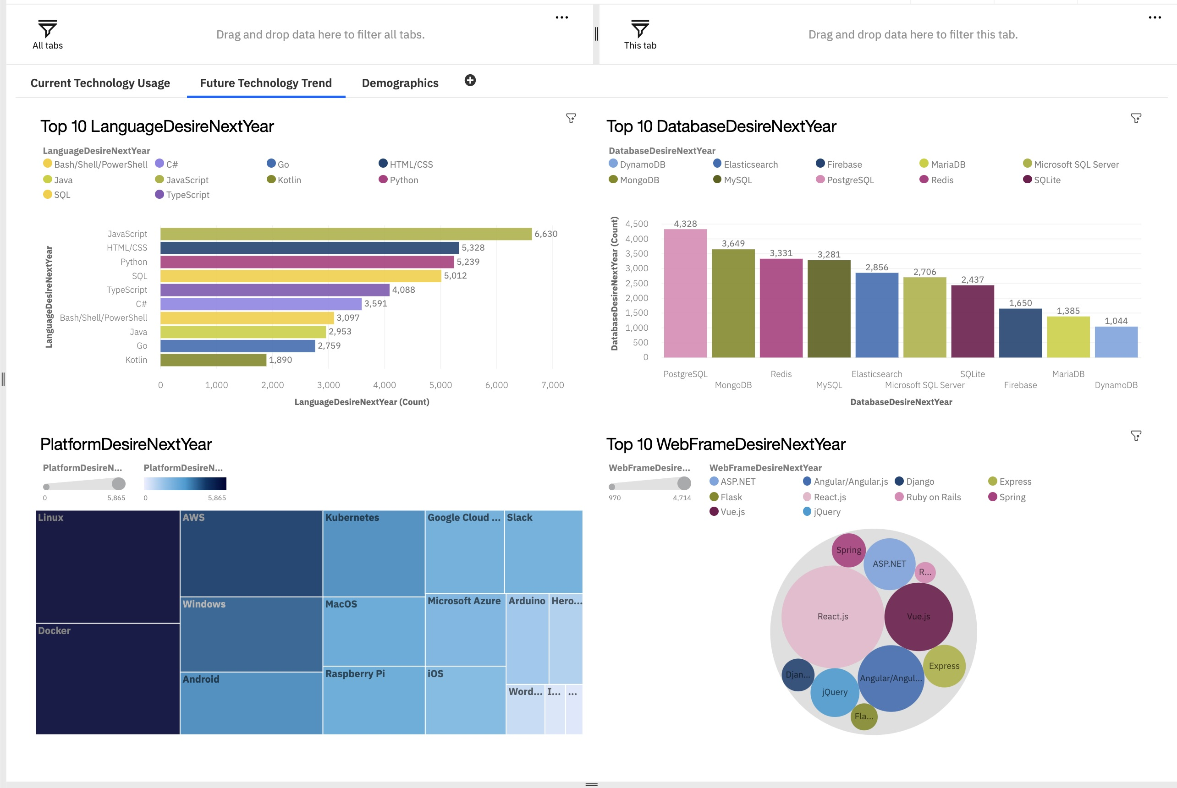
DASHBOARD TAB 1
Screenshot of dashboard tab 1 goes here

Slide 12
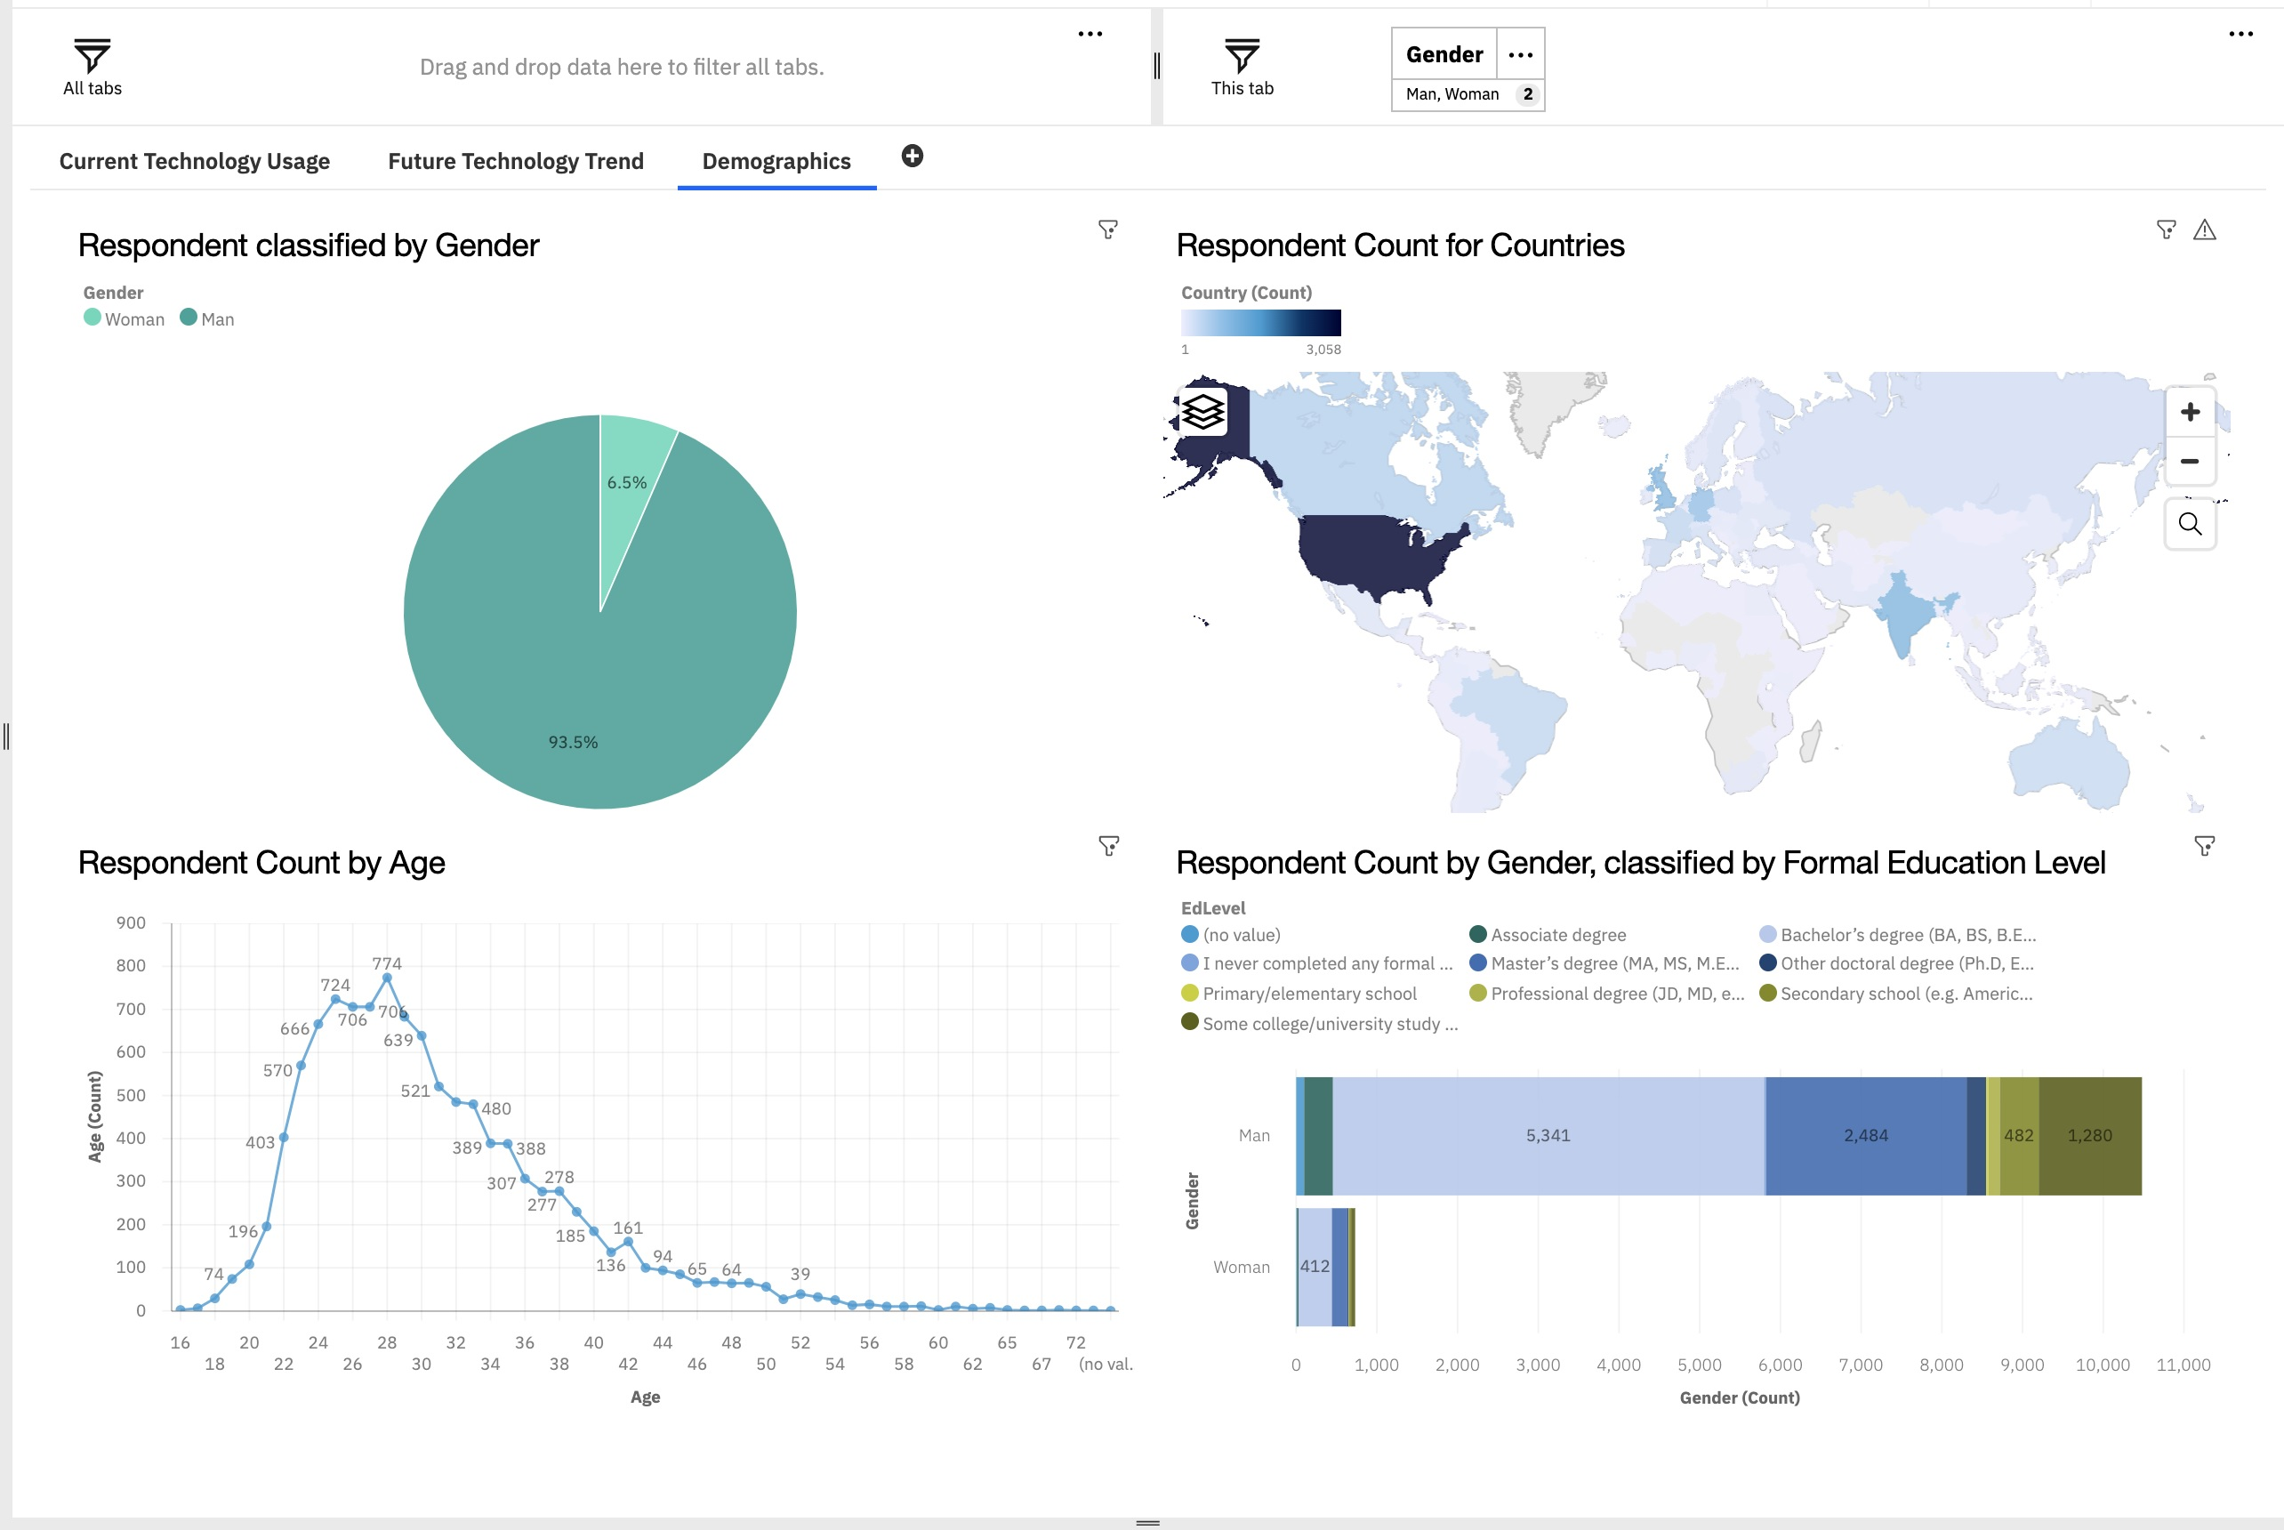
DASHBOARD TAB 2
Screenshot of dashboard tab 2 goes here

Slide 13
DISCUSSION:
It has been noted by this report that a large increase of home platforms, 26%, has been increased since last year 2019. Pandemic times means home based jobs, and therefore more use of Web resources, in Databases, 19% increase, and Platforms, (22%).
As it has been noted for the last 10 years, Java is the most used programming languages in all of these years, taking into account it was the first Object relation Language famously used(+27%)
It is worth mentioning that AI is translating languages used by programmers. Thus, they feel more motivated to work on Pythoh, and R. (58%).
MySql has stopped being the first database used. Contrarily, MicrosoftSQL seems the top database chosen to work on home job based by majority of users (28%)

Slide 14
OVERALL FINDINGS & IMPLICATIONS
Findings:
It has been a large number of users trying to work home based because of pandemic results. Most of them use the Web as a tool.
Large part of home-programmers are using other kind of languages to perform AI details with ML or DL.
Databases are needed to keep warehouses and interaction with cloud due to new needs on AI aspects.
It has been noted that Game Market needs new programming languages faster and more rapid drawings, and able to be shared.
Implications:
Old languages, platforms and databases are not valid nowadays. Modern duties need a faster and more memory capacity to perform a better performances.
Python is ranked the first top one for the forecasting as tools to practice many practices inside AI. R languages is on the rise too.
MicrosoftSQL and Oracle are placed the top on the market of user due to its readiness to connect whith AI modern needs.
C++ and C are being more used by home-programmers who make up games with them.

Slide 15

CONCLUSION
Large number of people are now home job based because of pandemic times.
Main part of these jobs are related to web use, directly or indirectly.
Programs, languages, platforms well used during 2020 are in no use now due to change of IT environments and new needs for it.
AI is asking for new program languages to develop DL, ML, and Cloud developing.

Slide 16
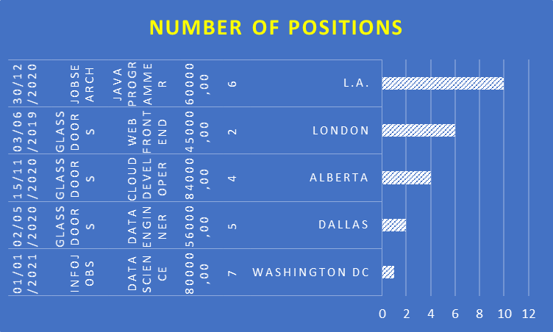
GITHUB JOB POSTINGS
In Module 1 you have collected the job postings data using GitHub API in a file named “github-job-postings.xlsx”. Present that data using a bar chart here. Order the bar chart in the descending order of number of job postings.

